Slide 1
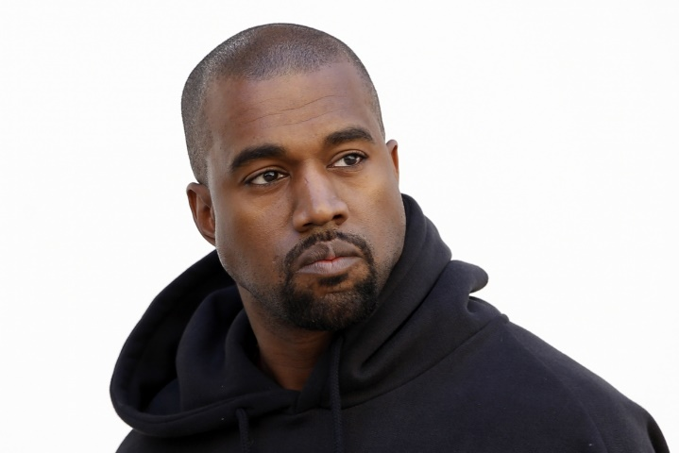
You have to Serve Somebody
"When you hear about slavery for 400 years ...
For 400 years? That sounds like a choice… You were there for 400 years and it's all of y'all. It's like we're mentally imprisoned."

Slide 2
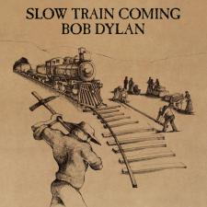
You have to Serve Somebody
“But you’re gonna have to serve somebody, yes indeed you’re gonna have to serve somebody.
Well, it may be the devil or it may be the Lord but you’re gonna have
to serve somebody.”

Slide 3
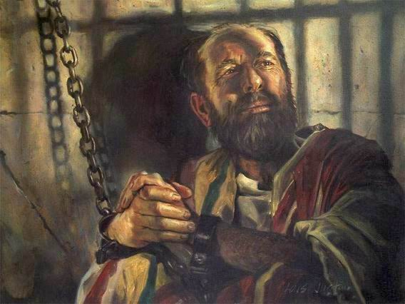
You have to Serve Somebody
For though I am free from all men, I have made myself a servant to all… Now this I do for the gospel's sake…” (1 Cor. 9:22-23)
“Paul, a bondservant of Jesus Christ…” (Romans 1:1a)

Slide 4
You have to Serve Somebody
Born a Child of God
by Faith Alone in Christ Alone
“But as many as received Him, to them He gave the right to become children of God, to those who believe in His name…” (John 1:12-13)

Slide 5
You have to Serve Somebody
Become a Servant of God
by Faith Alone in Christ Alone
Are you a good and faithful Servant of God or
a Wicked and Lazy Servant?
“If anyone serves Me, let him follow Me…” (John 12:26a)

Slide 6
You have to Serve Somebody
Become a Servant of God
by Faith Alone in Christ Alone
Are you a good and faithful Servant of God or
a Wicked and Lazy Servant?
Parable of the Talents
Matthew 25:14-30

Slide 7
You have to Serve Somebody
Become a Useful, Faithful and Righteous Servant of God
though Perseverance and Suffering
“Well done, good and faithful servant; you were faithful over a few things…” (Matt. 25:21a)

Slide 8
You have to Serve Somebody
Become a Unprofitable, Lazy and Wicked Servant of God
by Doing Nothing
“And I was afraid, and went and hid your talent in the ground. Look, there you have what is yours.” (Matt. 25:25)

Slide 9
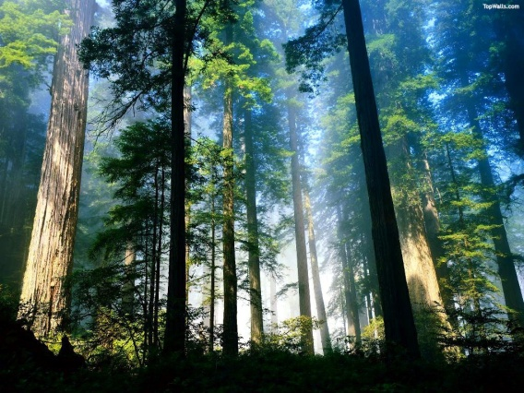
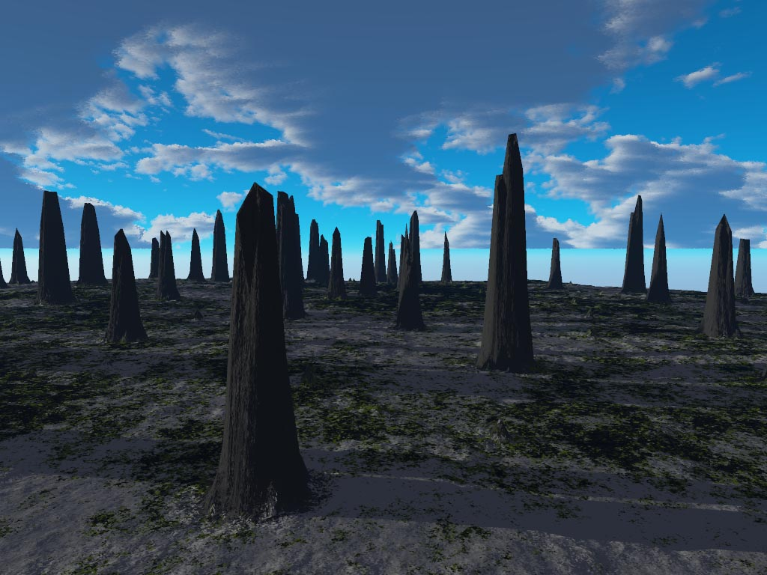
Notes:
"Until the cities are laid waste and without inhabitant, the houses are without a man, the land is utterly desolate, the LORD has removed men far away, and the forsaken places are many in the midst of the land. But yet a tenth will be in it, and will return and be for consuming, as a terebinth tree or as an oak, whose stump remains when it is cut down.” (Isa 6:11-13)

Slide 10
Notes:
“So the holy seed shall be its stump.“ (Isa 6:13) - Bloom out of Doom.

Slide 11
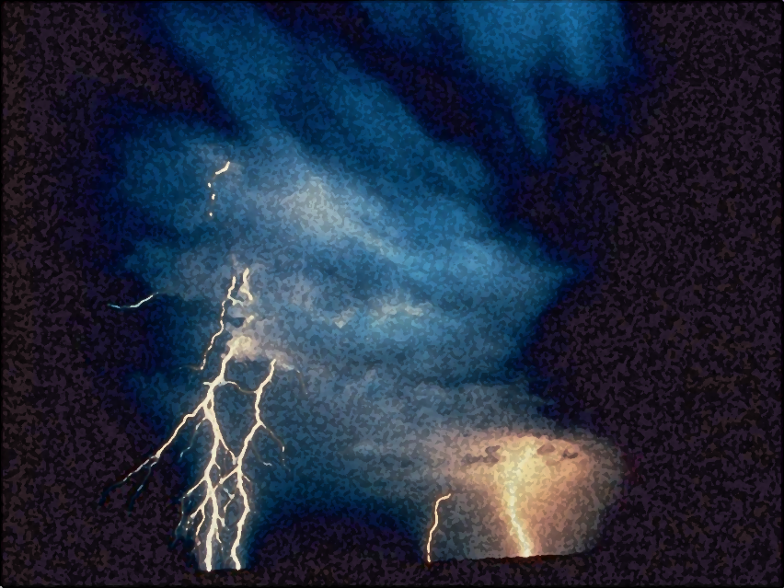

A Light out of Darkness
The Vision of Isaiah
Doom to Bloom

Slide 12


The Vision of Isaiah
A Call to Servanthood
How to become a useful, faithful and righteous servant of God?

Slide 13
The Vision of Isaiah
In Whom Shall We Trust?
The Basis of Servanthood
7-39
To become a Servant of God, one must first trust in the one whom they serve.

Slide 14
The Vision of Isaiah
In Whom Shall We Trust,
the Nations or the LORD?
Example of Distrust
7-12
Ahaz
God: Master of the Nations
13-35
Example of Trust
36-39
Hezekiah
Notes:
Chapter 7-12 gives us an historical example of distrust in the LORD. King Ahaz is given an opportunity to trust in the Lord but refuses to listen, a fulfillment of 6:9-10. The LORD offers him a sign, evidence that the LORD can be trusted. But He refuses to accept the sign. He refuses to trust in the LORD and His word. He instead decides to trust in Assyria and their many gods. Ahaz seeks the help of Tiglath-Pileser king of Assyria, but receives no help, but more trouble. He gets rid of one problem and gets a bigger one in return. The LORD now makes an appearance, prophesied in the sign of Immanuel, “God with us” promised judgment and destruction is upon them when the LORD appears in the form of an invading army. Total destruction is averted at that time, but God will be back.
On the other end we have another historical example, one of trusted in the LORD. King Hezekiah is faced with the same problem, an invading army, the Assyrian have invaded and surrounded him and the nation, with no hope of escape or deliverance. Hezekiah seeks the LORD for help and trusts in the Him and is saved, from destruction and death. The invading army is miraculously destroyed by the LORD Himself. Ahaz trusts Assyria and Israel is destroyed. Hezekiah trusts the LORD and Assyria is destroyed.
Between the two segments is a section whose theme is the God of Israel is the Lord of the nations.

Slide 15
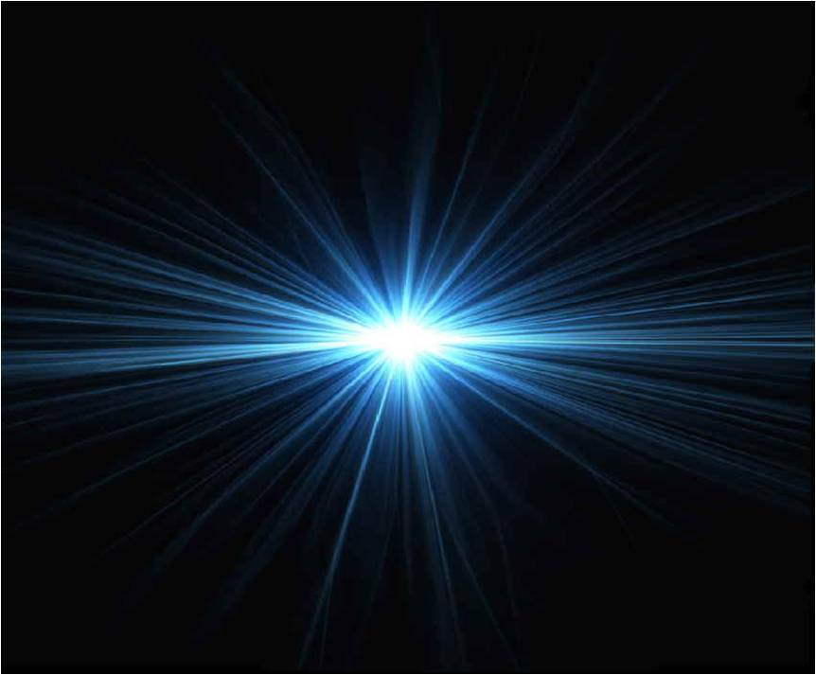
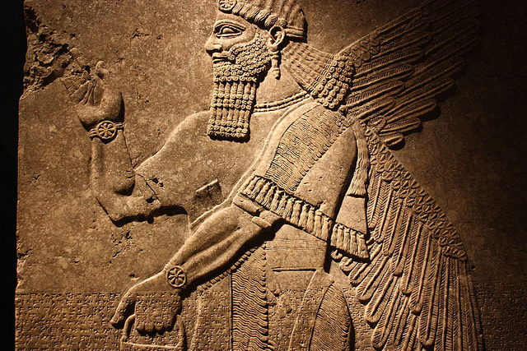
The Vision of Isaiah
God or Assyria?
An Example of Distrust
7-12
Notes:
In whom will Ahaz trust? The LORD of the universe of the lord of Assyria. In whom will man trust? God or Man. Will you choose light of darkness?

Slide 16
The Vision of Isaiah
Shear-jashub – 7:1-9
“a remnant shall return”
Immanuel – 7:10-25
“God with us”
Maher-shalal-hash-baz – 8:1-10
“quick to the spoil”
Notes:
God give three named children as evidence of His presence and workings in the nation and the world. God with us is both good and not so good. For those who trust in Him see the light of His goodness, those who distrust Him see only darkness and doom. But by His grace darkness can and will shine even for them.
Ahaz failed to trust in the Lord and was not established or protected from doom, but another child of David will be born, a son will be given who will established on Mt. Zion forever.

Slide 17
Will You Believe?
God is with Us
7:10 – 8:10
“Believe It or Not”

Slide 18
Will You Believe?
God is with Us
=
Immanuel
(7:10-17)
Maher-shalal-hash-baz (8:1-4)
=
Assyria
“like a razor”
(7:18-25)
Assyria
“like a flood”
(8:5-10)
Notes:
God will appear and bring judgment like a razor and like a flood in the form of an invading army, the destruction will not result in annihilation, but in salvation. Salvation through judgment.
Ahaz’s way brought death, destruction and darkness upon the land. God’s way brings life, prosperity and light. So listen, learn and live!

Slide 19
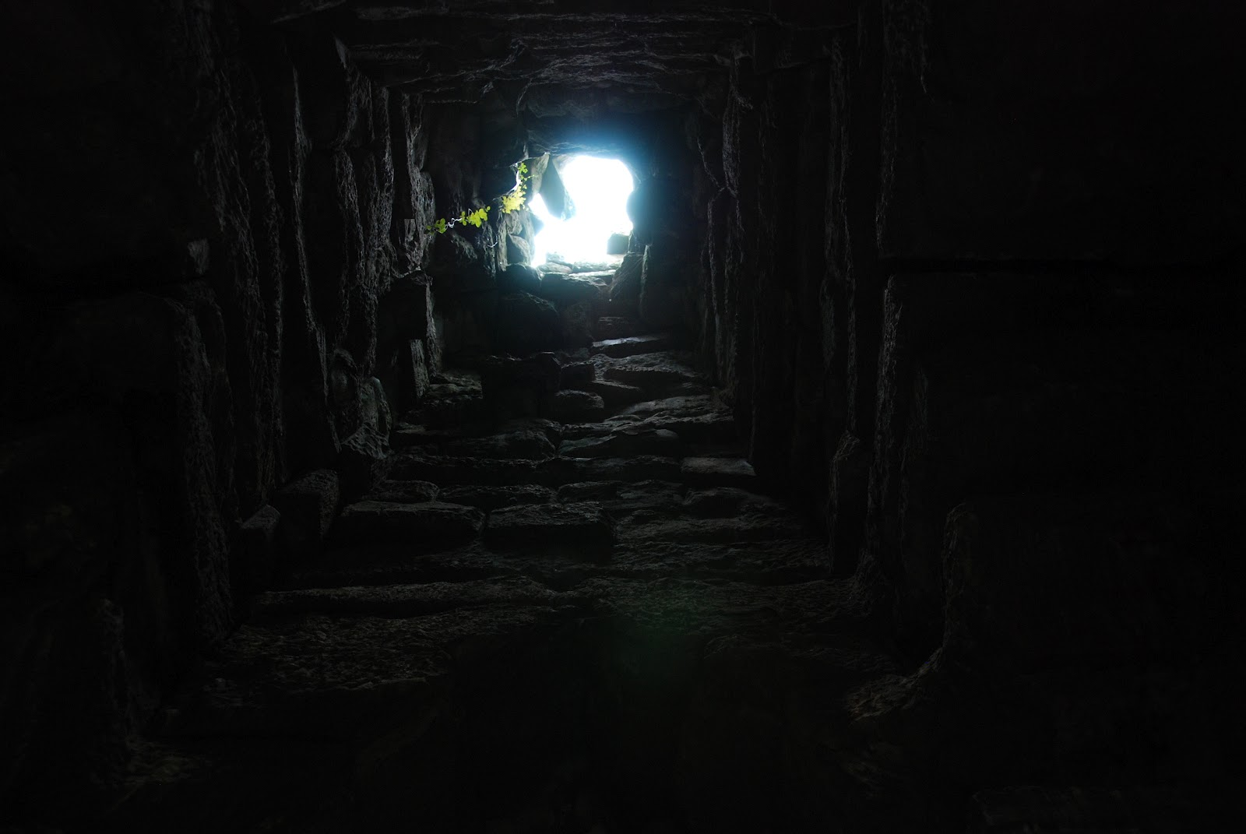
Will You Believe?
Our Way – Darkness;
His Way – Light
8:11-23
Notes:
This section establishes a reflection upon all which has preceded, begin in chapter 7. It prepares the way for the announcement of the description of the child and the kingdom that He will bring in chapter 9. And this is no ordinary child.
“It makes plain the central theme of the segment: “In what, or in whom, shall we trust?” One possibility when faced with potential calamities or disasters, is to forget God’s sovereignty and proceed accordingly, but to do so is to invite the calamity of more profound nature, for God is the one fact we dare not overlook. It is sheer foolishness (our way) , when he has made his way clear to resort to some other means to find a path out of darkness. These other means that man devises can only make the darkness, and our anguish, more intense, for they lead away from him who is the Light. Nevertheless, God will not be defeated. He will shed his light upon his people, it is typical of his grace that the location of that light will be in the part of the land which first felt the had of his wrath, namely Galilee.” (Oswalt, p. 231-232)
Man, when faced with political, social, and military upheavals focus upon various human conspiracies as the source of his troubles of which he gives primary attention. While they forget God as the source, people resort to magical and mystical means of divination and to learn the future and find guidance.
Isaiah’s response is that given God’s terrifying holiness, his written revelation, and his desires to give his people light, dependence upon anything other than him is sheer insanity.
Many, if not most commentators miss the thematic and theological unity of this section, because of the abrupt and indirect transition. This may be because that the material was not all composed at the same time. The speech is the result of a intense spiritual experience of the prophet.

Slide 20
Darkness or Light
“For the LORD spoke thus to me with a strong hand, and instructed me that I should not walk in the way of this people,” (8:11)
Notes:
“thus” suggest the linkage with the preceding segment. It give the reason why the plans of the nations will be thwarted. It is that they rest on all the wrong assumptions, which Isaiah’s own people have adopted themselves.
It includes a warning to Isaiah and his disciple not to go the way of the people themselves.

Slide 21
Darkness or Light
Do not say, ‘A conspiracy,’ concerning all that this people call a conspiracy, nor be afraid of their threats, nor be troubled. The LORD of hosts, Him you shall hallow; Let Him be your fear, and let Him be your dread. ” (8:12-13)
Notes:
The sense is very clear, namely give attention first to God, and not to human affairs.
It is very common and easy when situations go bad to become paranoid and suspicious in order to explain the events, i.e.: 911. Some of the people may have though Isaiah was behind the invasion of the Assyrians, after all he had predicted they would come and it would not go well with them.
“Isaiah challenges his people to reject paranoia and see God’s hand in the events of their time. To refuse to do so is to become more and more fearful, more and more unstable, for it means that our live are ultimately in the hands of unknown powers too devious for us to know or control. This leads one to the occult in an effort to gain knowledge, control, and power over…” (Oswalt, p. 233)
“The LORD of hosts, Him you shall hallow / sanctify…” How do you sanctify the LORD? You cannot make that which is holy, holy, or holier. He is holy, holy, holy! He is distinct from the common and ordinary. To make God holy is to for us to recognize that he is “high and lifted up” in power and in character as well as in His very essence.
Failing to sanctify Him is to make him common, appear helpless, indifferent and unimportant. And this is exactly what the Judeans did when they sought to solve the riddles of their times according to human explanations and means: they made God appear insignificant. Rather, Isaiah call upon them to make God the most significant fact of their existence.” (p. 234)

Slide 22
Darkness or Light
“He will be as a sanctuary, but a stone of stumbling and a rock of offense to both the houses of Israel, as a trap and a snare to the inhabitants of Jerusalem. And many among them shall stumble; They shall fall and be broken, be snared and taken.” (8:14-15)
Notes:
Read Oswalt page 234.

Slide 23
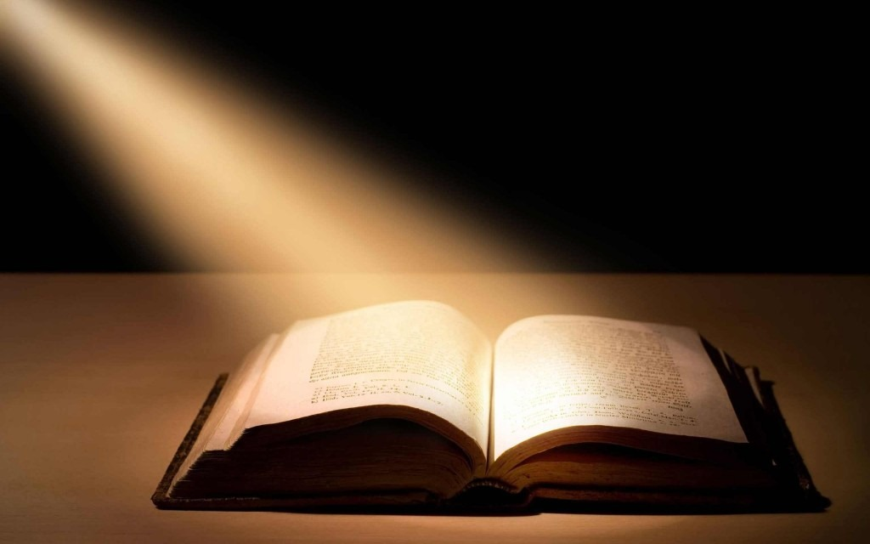
Darkness or Light
“Bind up the testimony, seal the law among my disciples.” (8:16)
Notes:
Verse 16-23 gives a further development of the thought contained in verse 11-15. “Those who choose to sanctify God to themselves will take refugee in his character as revealed in his word and have reason for hope, and a light will shine out of darkness. Those who refuse to do so will be driven to magic and the occult and thus into deeper darkness and despair. (p. 225)
Isaiah is reaffirming his dependence upon God as revealed in His written Word and challenges those who follow him to do the same.

Slide 24
Darkness or Light
“And I will wait on the LORD, Who hides His face from the house of Jacob; And I will hope in Him. Here am I and the children whom the LORD has given me! We are for signs and wonders in Israel from the LORD of hosts, Who dwells in Mount Zion.” (8:17-18)
Notes:
Isaiah affirms his trust and dependence on the LORD, even though He seems to be hiding His face from Judah and Israel who have forsaken Him. Isaiah will not lose his faith in Him or turn to some other source to gain strength and courage.

Slide 25
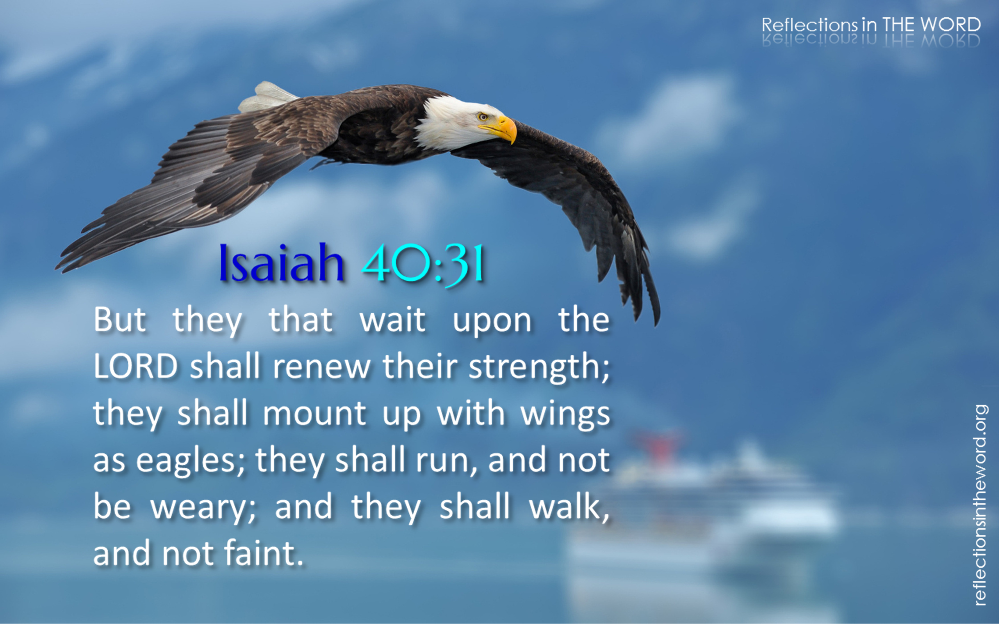
Darkness or Light
Notes:
God’s timing is best and that he will wait for his action… This waiting upon God is often a prerequisite to receiving His blessing. While waiting we admit our helplessness and our complete dependence upon Him.

Slide 26
Darkness or Light
“And I will wait on the LORD, Who hides His face from the house of Jacob; And I will hope in Him. Here am I and the children whom the LORD has given me! We are for signs and wonders in Israel from the LORD of hosts, Who dwells in Mount Zion.” (8:17-18)
Notes:
The strangely evocative named children, “a remnant shall return, God is with us, and quick to the spoil” and even Isaiah, the LORD saves, all reflect God’s working among His people. The names give evidence that although His face might be hidden for a time, it is still true that his dwelling is upon Mt, Zion. He is establish there.

Slide 27
Darkness or Light
“Now it shall come to pass in the latter days that the mountain of the LORD's house shall be established on the top of the mountains, and shall be exalted above the hills; and all nations shall flow to it.” (2:2)
Notes:
The strangely evocative named children, “a remnant shall return, God is with us, and quick to the spoil” and even Isaiah, the LORD saves, all reflect God’s working among His people. The names give evidence that although His face might be hidden for a time, it is still true that his dwelling is upon Mt, Zion. He is establish there.

Slide 28
Darkness or Light
“And when they say to you, ‘Seek those who are mediums and wizards, who whisper and mutter,’ should not a people seek their God? Should they seek the dead on behalf of the living? To the law and to the testimony! If they do not speak according to this word, it is because there is no light in them.” (8:19-20)
Notes:
For those who distrust the LORD, a all-wise and all-loving creator, turn to Spiritism and to the doctrines of demons, who are behind them. The mediums and wizards seek whom? The living God. No. They seek the dead? It is a ridicules notion to seek the dead who know nothing on behalf of the living. Those who reject life turn to the dead to discover the meaning of life. So their darkness deepens. There is no light, no truth in them. They gain no knowledge or power.
Those in darkness seek the truth as if it is hidden, but it is not hidden to those who will look in the right place. God has been shouting it from the rooftops and recording it for all generations, “to the law and testimony”! As Jesus said, “Have you not heard, have you not read…” The way, the truth and the life is only hidden from those who refuse to hear what God has made plain.”
“no light” is the early light, that is, “no dawn”. If one refuses the Word of the LORD then one is condemned to a night from which there is no dawn.
“mediums” – ventriloquist; “wizards” – those who talk to the dead, but not really.

Slide 29
Darkness or Light
“They will pass through it hard-pressed and hungry; and it shall happen, when they are hungry, that they will be enraged and curse their king and their God, and look upward. Then they will look to the earth, and see trouble and darkness, gloom of anguish; and they will be driven into darkness.” (8:21-22)
Notes:
The general sense is this, “Those who lack a truly divine perspective on their affairs, who succumb to the occult for their guidance, plunge themselves further and further into gloom, spiritual famine and despair.” (p. 238)
What they pass through is a condition where there is “no dawn”. The specific cause of their distress is their emptiness, which is expressed in anger toward those who seemingly might be able to do something about it but are not willing. They look up and find no help or relief from their emptiness and the look down and find the same. They only find others who are in the same predicament. Those who look to the earth for solutions find none. To the stars, Mars?
Light for darkness must come from outside of ourselves if it is to come at all. Darkness can swallow up failing light, but it can never produce light. (p. 239)

Slide 30
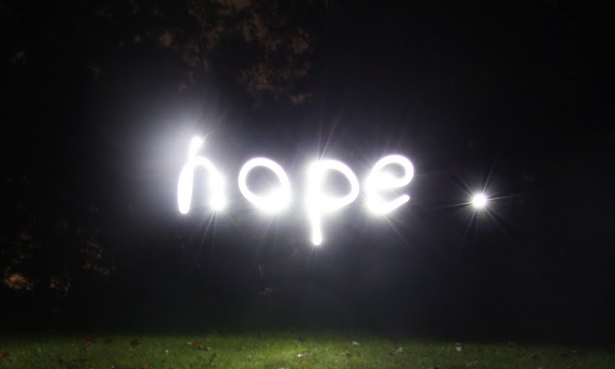
Darkness or Light
Notes:
There is hope. Hope shines out of darkness. The gloom and the doom is not final. The darkness and emptiness is not an end in itself but a means whereby God’s goodness can be manifested in the salvation of a land now aware of the true source of its life. When every human attempt to bring light has failed, then God will bring light, not because He has to, or that man has force Him, but merely out of His own grace, it is a gift of God.

Slide 31
Darkness or Light
“Nevertheless the gloom will not be upon her who is distressed, as when at first He lightly esteemed the land of Zebulun and the land of Naphtali, and afterward more heavily oppressed her, by the way of the sea, beyond the Jordan, in Galilee of the Gentiles.” (8:23, 9:1)
Notes:
The land where God’s gracious light will dawn first is the land that first experienced the hit and destruction of Assyria, the land of Galilee. Though God humiliates His people, he never does so without a corresponding exaltation plan.

Slide 32
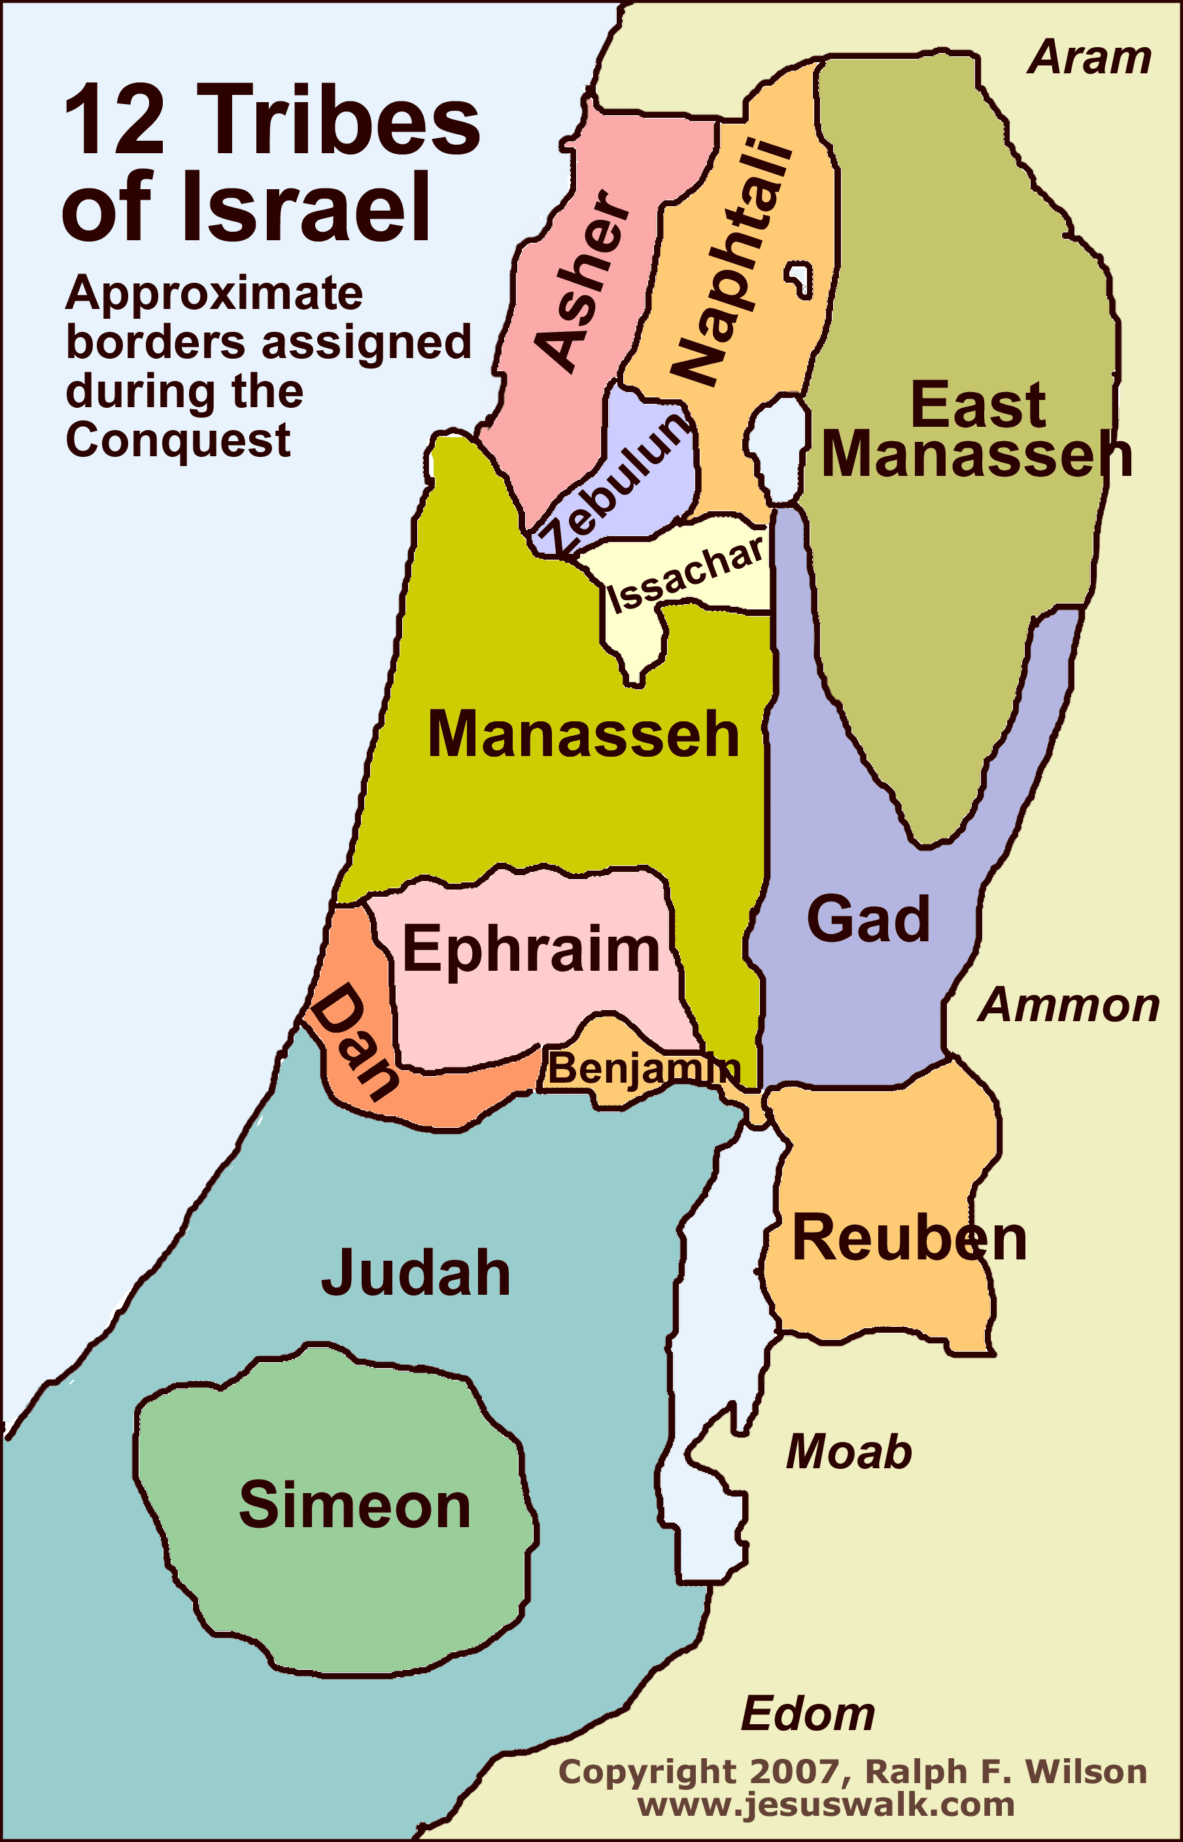
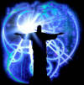
Darkness or Light
The land between the seas.
Notes:
This was the first part of Israel that was stripped away by the invading army of Assyria. The inhabitants resettled in Assyria and new settlers were brought in. Israel thought the land was hers, but learned that she was only a tenant by permission of the true landlord.
All Israel was involved in the rebellion and forsaking of the LORD, and all Israel will participate in the redemption and restoration, if only in a small remnant form. The doom will turn to a bloom when the LORD first appears from the land of Galilee, where a people walking in darkness shall see a great light.

Slide 33
The Vision of Isaiah
Notes:
Trust the Lord and believe His signs/evidence that His Word is true, and you will be established on the earth. Distrust the LORD and refuse the evidence and perish from the earth.

